Slide 1
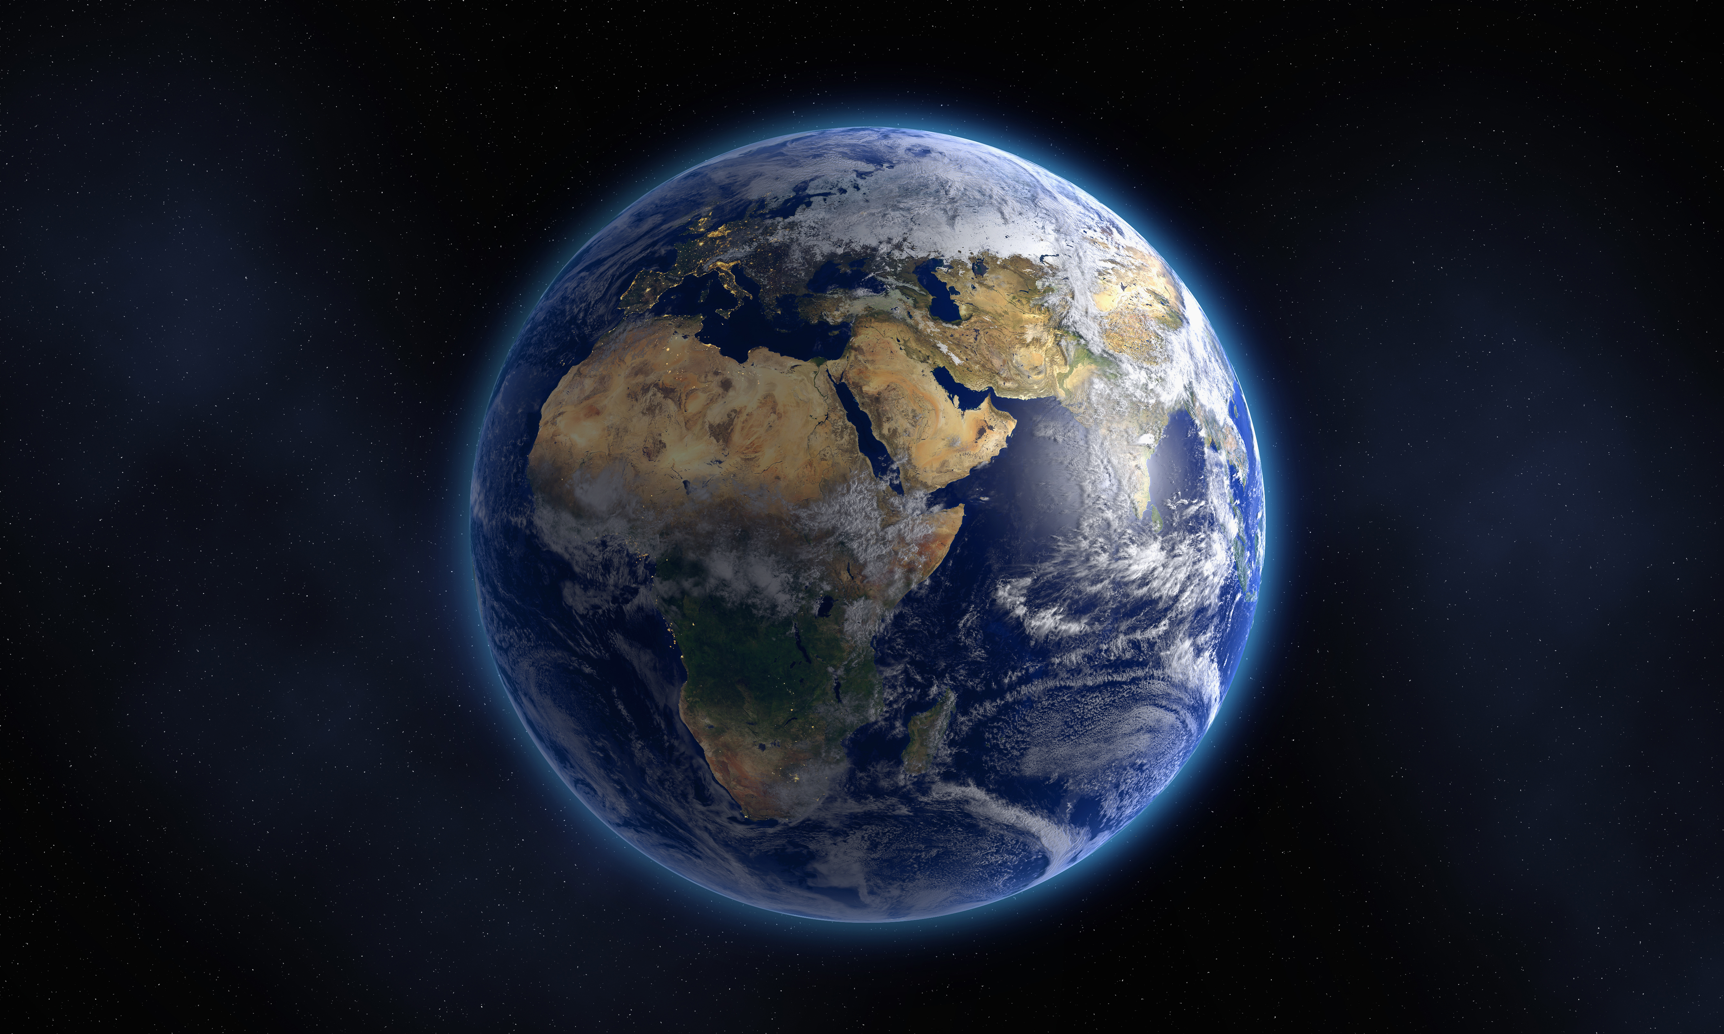
Satellites and Conservation
**YOUR DISCOVER CENTRE NAME HERE**

Slide 2
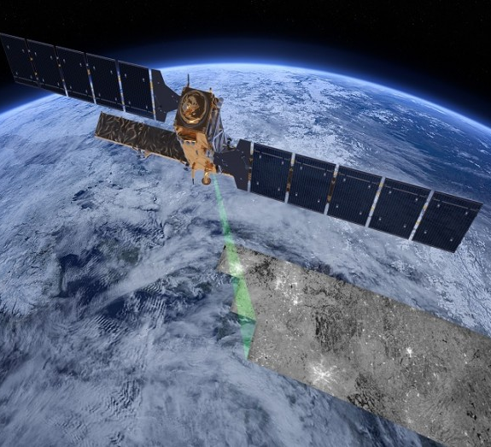
Earth Observation Satellites
Space science isn’t all about looking out – Earth observation satellites look back in
Satellites allows us to study our own planet at a variety of scales. From tracking individual animals to surveying global ocean patterns and temperatures.
Sentinel 1 Satellite. Credit: European Space Agency

Slide 3
Tracking Animals
This map shows the migratory patterns of the Swainson’s Hawk in the Americas over a period of 8 months
Each colour represents an individual bird. Each was fitted with a transmitter and its position was tracked by satellites
Credit: Smithsonian National Zoo and Conservation Institute

Slide 4
Monitoring Habitats
This image was captured by NASA’s LANDSAT 9 Satellite
It shows an area of Irish peatland that has been drained and cut
Images like this can be used to track illegal peat extraction or to monitor habitat recovery
Credit: NASA Earth Observatory

Slide 5
Other Options To Consider
Wildlife Relevant Prompts
Habitat and Climate Prompts
Penguins can be tracked by their waste from space – Source
Space Tech used to track orangutans - Source
Endangered Irish curlew tracked via satellites – Source
Satellite tagging of basking sharks in Ireland - Source
Deforestation in Brazil tracked via satellite – Source
Satellites shows the retreat of Greenland glaciers – Source
Monitoring sea surface temperature – Source
Satellites show impacts of fires set in National Parks - Source

Slide 6
Pivot to YOUR Domain Knowledge
“We’ve learned how satellites can track changes to (peatlands/national parks/oceans/etc.), but why are they so important? Let’s explore this question together…”
“We’ve learned how satellites can be used to track animals all over the world, and even how we can use satellites to count them, but now we’re going to discuss conservation efforts closer to home. Did you know that Ireland is home to (Species name) and they can be found right here at…”
“Now that we’ve learned about how satellites can be used to monitor animal populations in the wild, let’s learn about other conservation methods such as the breeding programs we operate here at…”

Slide 7
You’re The Expert
You don’t need expertise in space science to run a Space Week event.
You just need to add some space related context before doing what you do best.
The examples in this presentation are more than enough to add a touch of space to your outreach.
If you would like further assistance, just ask. Reach me at rob.osullivan@bco.ie

Slide 8
Don’t forget to register!
We’ll help you promote your event
You can charge for your event if you wish
Register your event at the Space Week website
Thank you and have a great Space Week!

