Slide 1


Sustainable Space
**YOUR CENTRE NAME HERE**

Slide 2
No Space For Waste
For Astronauts on board the International Space Station, or traveling to other planets – Resources are scarce
Currently we have no resources beyond those we can bring with us and this is still incredibly costly – At the cheapest, €2-3000 per kg
Recycling resources is vital – Water is kept in a closed-loop system on the ISS. Astronaut sweat, urine and exhaled water vapour are all captured and purified for reuse.

Slide 3
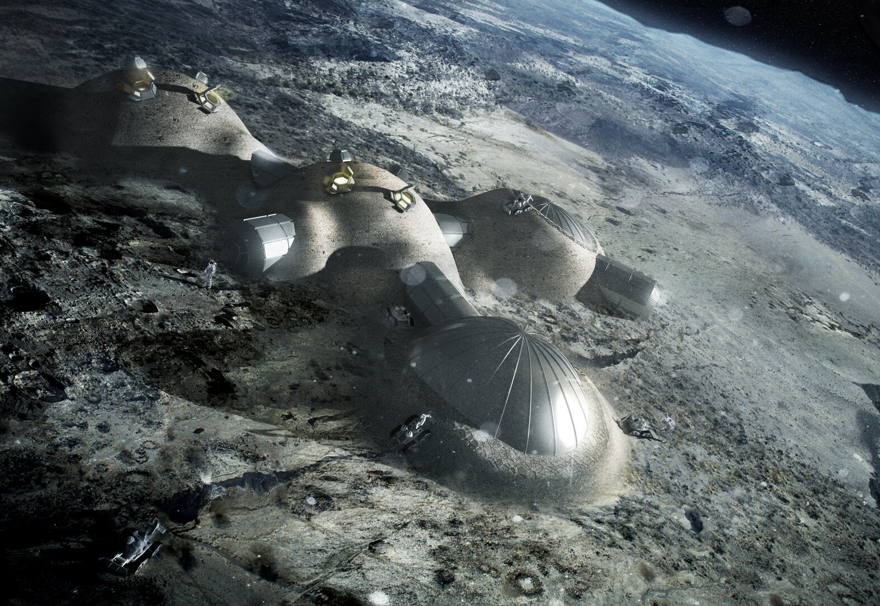
Use Local Materials
If we are to establish bases on the Moon or Mars, using local material will be vital.
Water (H2O)on the Moon can be split with electricity to produce Hydrogen rocket fuel (H2) and breathable Oxygen (O).
Lunar regolith (Moon dirt) can be used to 3D print structures
Image: Artist Impression of 3d Printed Lunar Base. Credit: ESA/Foster + Partners

Slide 4
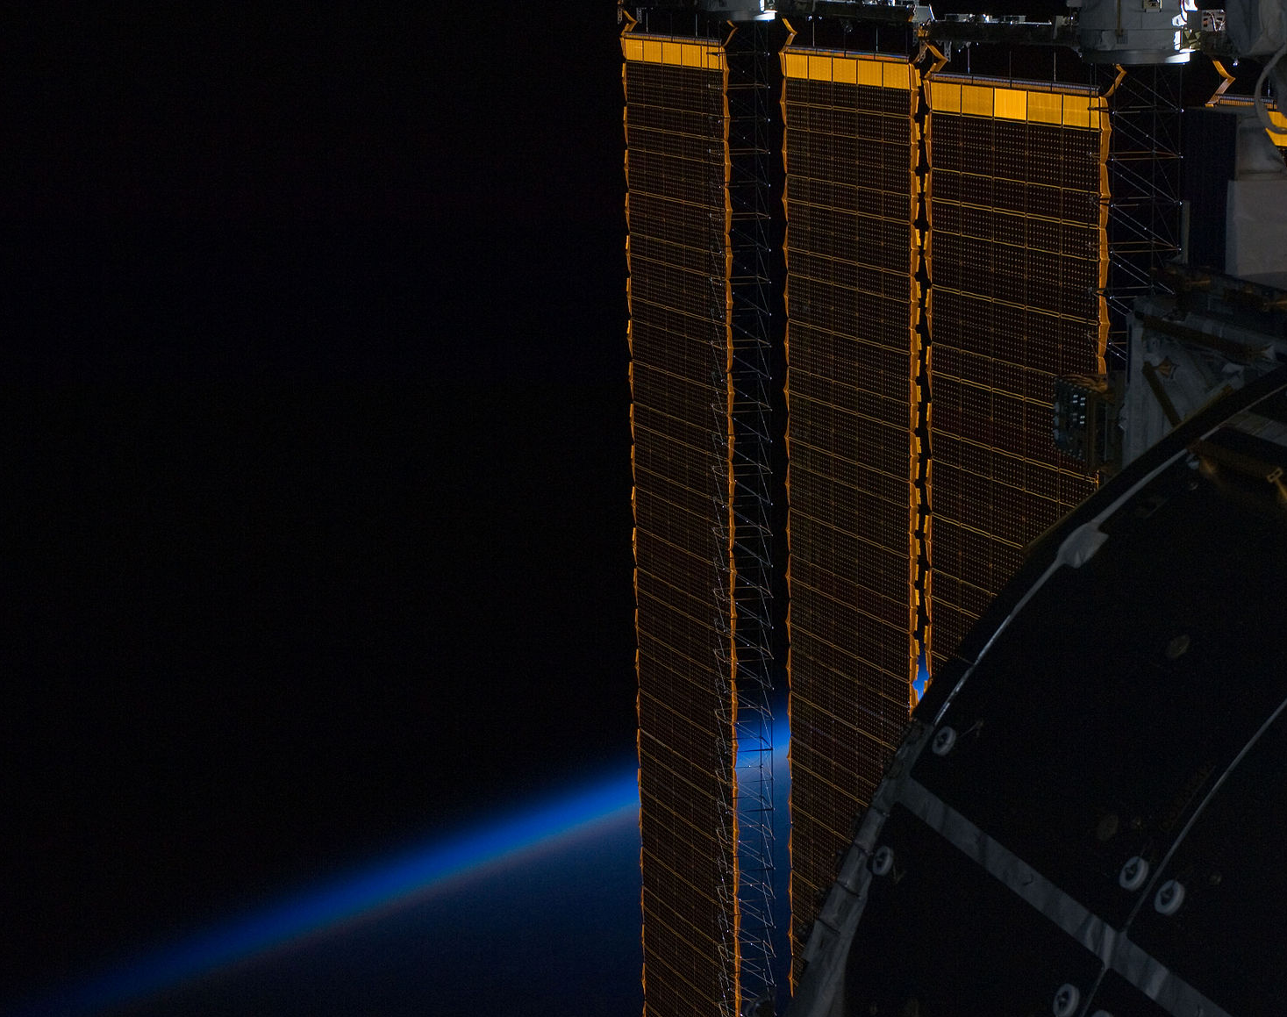
Sustainable Energy
The International Space Station is dependent on solar energy to power its operations
It does so with the huge Solar Array Wing
Because it is not always in sunlight it must use rechargeable batteries to sustain power as it orbits the planet
Image: A section of the Solar Array Wing

Slide 5
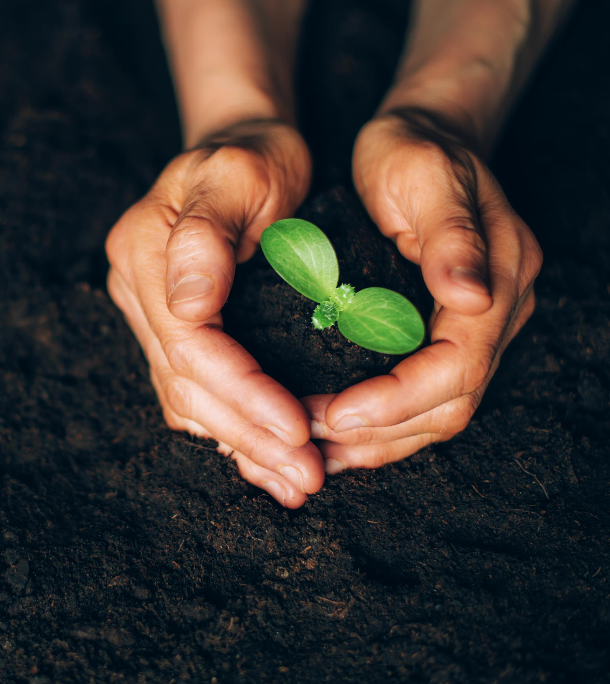
Sustainable Agriculture
By learning to grow food in the harsh conditions of Space, we can improve our knowledge of how to grow those same crops in harsh environments on Earth
Scientists in Peru successfully grew potatoes in artificial Martian soil – Source
Satellites imagery may eventually allow us to reduce fertiliser usage in a targeted way - Source

Slide 6

Pivot To Your Expertise
“We’ve seen some examples of how space science can inform sustainable living here on Earth, but why is this so important? Well here at …”
“We know sustainability is necessary for space travel, but is it as important here in Ireland? Here are some examples of sustainable programs here at…”

Slide 7
Prompts for Further Discussion
Asteroid Mining?
Will the resources available in asteroids solve shortages here on Earth?
Will these resources be harvested equitably?
Do we have the right to mine the Moon?
What do you think?
Space Junk
Do we need to limit the amount of satellites etc. we send to space to reduce the build-up of junk?
How will we tackle the problem of space-junk already in orbit?
Whose responsibility is it?
What do you think?

Slide 8
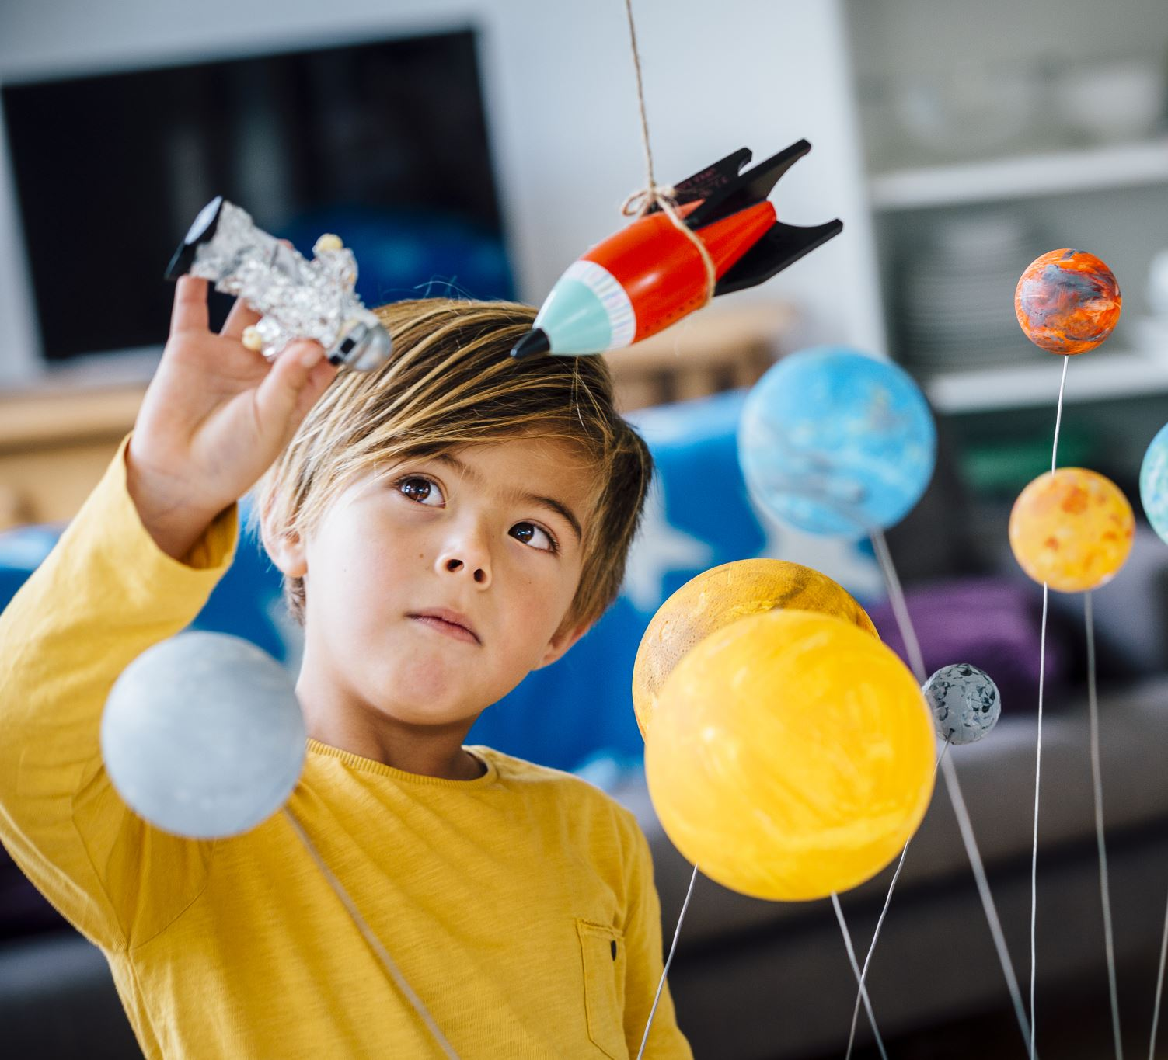
You’re The Expert
You don’t need expertise in space science to run a Space Week event.
You just need to add some space related context before doing what you do best.
The examples in this presentation are more than enough to add a touch of space to your outreach.
If you would like further assistance just ask. Reach me at rob.osullivan@bco.ie

Slide 9

Don’t forget to register!
We’ll help you promote your event
You can charge for your event if you wish
Register your event at the Space Week website
Thank you and have a great Space Week!

